Slide 1
Guess game: description
A player has an endowment.
Random number is generated within certain limits
A player has to guess. The closer is the guess to a real number the larger is the profit.
Two fields: what is guessed, and a player’s decision
Three screens:
Intro: instructions
Decision with instructions
Results

Slide 2
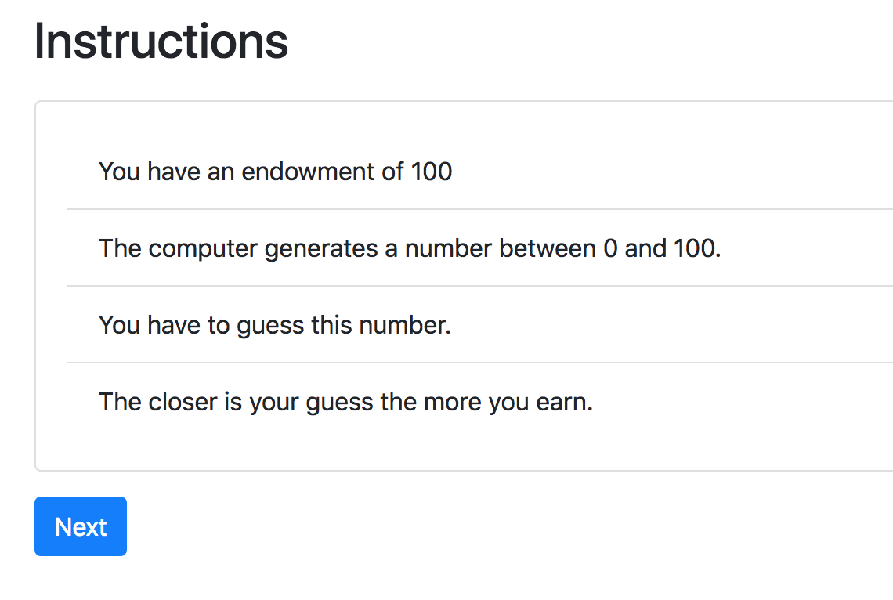
Guess game: screen 1

Slide 3
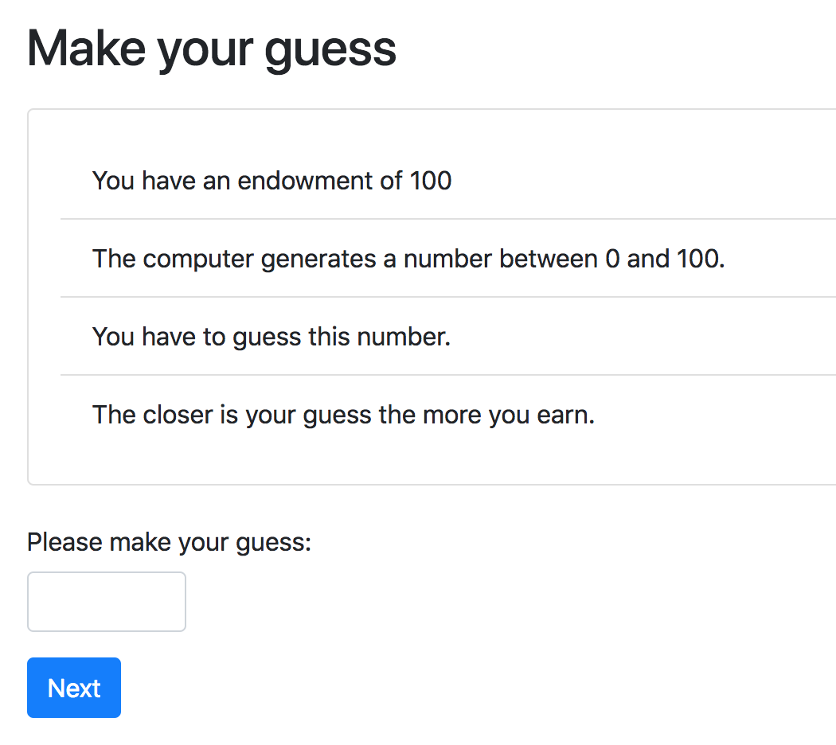
Guess game: screen 2

Slide 4
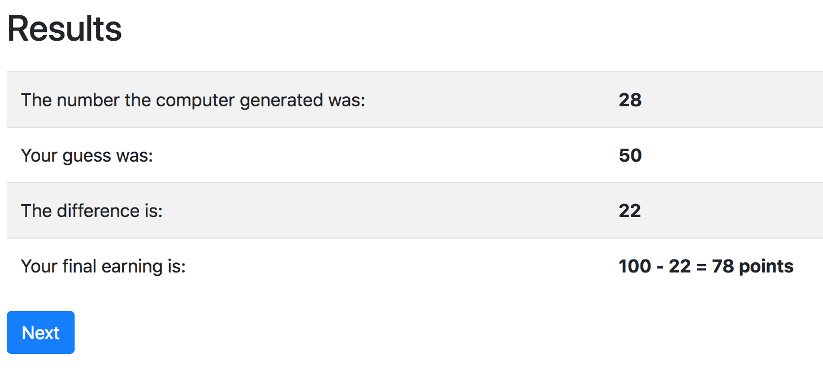
Guess game: screen 3

Slide 5
Guess game: models.py
class Player(BasePlayer): toguess = models.IntegerField(min=Constants.minguess, max=Constants.maxguess,) guess = models.IntegerField(label='Please make your guess', min=Constants.minguess, max=Constants.maxguess, ) diff = models.IntegerField() def set_payoff(self): self.diff = abs(self.guess - self.toguess) self.payoff = Constants.endowment - self.diff

Slide 6
Guess game: models.py
import random class Constants(BaseConstants): endowment = 100 minguess = 0 maxguess = 100 class Subsession(BaseSubsession): def creating_session(self): for p in self.get_players(): p.toguess = random.randint(Constants.minguess, Constants.maxguess)

Slide 7
Guess game: pages.py
Creating new page
Class NameOfThePage(Page):
pass
page_sequence
page_sequence = [NameOfThePage]
By default name of the template corresponds to the page name!

Slide 8
Guess game - Templates
{% extends "global/Page.html" %}
{% load static otree %}
{% block title %} YOUR TITLE HERE {% endblock %}
{% block content %}
YOUR CONTENT HERE
{% endblock %}

Slide 9
Templates: using variables
In a template you can access variables defined in vars_for_template of the specific page:
{{ var }}
You can also use lists and dictionaries
You can also access any variable in Constants, Player, Group…
{{ player.payoff }}
{{ Constants.endowment }}

Slide 10
Guess game - Templates
to include another file (for example instructions):
{% include 'path_to_file/name_of_file.html' %}
to make ‘Next button’:
{% next_button %}

Slide 11
Guess game: pages.Intro

Slide 12
Intro.html
{% extends "global/Page.html" %}
{% load staticfiles otree_tags %}
{% block title %}Instructions{% endblock %}
{% block content %}
{% include'guess_random/instructions.html' %}
{% next_button %}
{% endblock %}

Slide 13
instructions.html
{% load otree static %} <div class="card mb-3"> <div class="card-body"> <ol class="list-group list-group-flush"> <li class="list-group-item">You have an endowment of {{ Constants.endowment }}</li> <li class="list-group-item">The computer generates a number between {{ Constants.minguess }} and {{ Constants.maxguess }}. </li> <li class="list-group-item">You have to guess this number.</li> <li class="list-group-item">The closer is your guess the more you earn.</li> </ol> </div> </div>

Slide 14
pages.Decision

Slide 15
pages.Decision. How to do it?
Referring to models. field in pages.py:
class Decision(Page):
form_model = 'player'
form_fields = ['guess']
referring to a field in a template:
{% formfield player.guess %} OR {{form}} or {% formfields %}

Slide 16
pages.Decision
{% extends "global/Page.html" %} {% load otree static %} {% block title %} Make your guess {% endblock %} {% block content %} {% include 'guess_random/instructions.html' %} {% formfield player.guess %} {% next_button %} {% endblock %}

Slide 17
pages.Results

Slide 18
Pages.Resuts. How to do it?
in pages.py: Decision page:
class Decision(Page):
...
def before_next_page(self):
self.player.set_payoff()
in models.py :
class Player(BasePlayer):
…
def set_payoff(self):
self.diff = abs(self.guess - self.toguess)
self.payoff = Constants.endowment - self.diff

Slide 19
pages.Results
<table class="table table-hover table-striped"> <tr> <td>The number the computer generated was:</td> <th>{{ player.toguess }}</th> </tr> <tr> <td>Your guess was:</td> <th>{{ player.guess }}</th> </tr> <tr> <td>The difference is:</td> <th>{{ player.diff }}</th> </tr> <tr> <td>Your final earning is:</td> <th>{{ Constants.endowment }} - {{ player.diff }} = {{ player.payoff }}</th> </tr> </table>

Slide 20
Running the app
otree devserver
go to: http://127.0.0.1:8000

